Slide 1


Freshers Training Plan – Services Team

Slide 2
Training Plan
Objectives
Programming skills – 35% marks
Hands on training for 7 weeks – 5% per week
Deep dive for 2 weeks
Development at scale – 50%
Individual project – 20%
Team based development – 30%
Breadth of knowledge – 15%
Weekly team presentation of a topic 2.5%

Slide 3
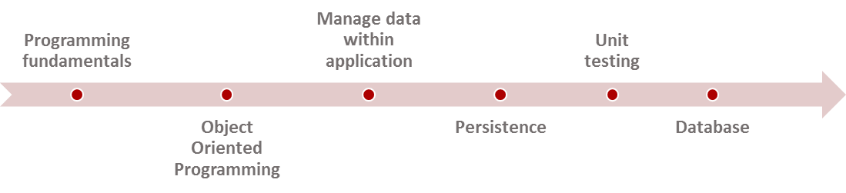


Training Plan
Week 1
Week 2
Week 3
Week 4
Week 5
Week 6
Week 7
Week 8, 9
Specialization
In depth knowledge in one area
Individual Project
Team Project
Weekly Presentation

Slide 4
Day 6 – Persistence
Exercises
Extend the Employee information [CRUD based] and add persistence
Add capability to search for a particular employee
Enhance the Employee information application to maintain monthly pay slips for each employee
Implement the Employee information application to track all projects [assume employees to be working on multiple projects simultaneously] each employee is working on
Add capability to search for a all projects an employee is working on or list all employees working in a particular project
Convert the log messages to go into a file instead of the console.
If the number of employees is too large to bring all records into memory for processing, how will manage the CRUD operation in this scenario?
Ensure for the above code, you are handling all situations (E.g. File is not available in the specified location, file is locked by another user etc.). Make sure that at each step you are logging the processing being done in the application.

Slide 5
Day 7 – Persistence
Exercises
Add capability to search for a particular employee using a Hash table
Ensure for the above code, you are handling all situations (E.g. Search element not in list of employees). Make sure that at each step you are logging the processing being done in the application.
https://medium.freecodecamp.org/how-to-implement-a-simple-hash-table-in-javascript-cb3b9c1f2997
Read the difference between Object, map, HashMap in JavaScript
Use a random access file to store employee information
Add capability to search for a particular employee in the random access file using a simple index using an in=memory Hash table
Read the differences between different database indexing mechanisms
https://en.wikipedia.org/wiki/Database_index
Implement Merge Sort and binary search for the employee records

Slide 6
Day 8,9 – NodeJS, NPM, Unit testing
Exercises
Write unit test for the capability to search for a particular employee using a Hash table. Make sure the code coverage is 90% or above.
Some free books on NodeJS https://devfreebooks.github.io/nodejs/
Write unit test for the capability to search for a particular employee in the random access file using a simple index using an in-memory Hash table. Make sure the code coverage is 90% or above
Unit test the operations in the Calculator module
Jest Framework - https://jestjs.io/docs/en/getting-started.html
How to use Jest - https://www.xoriant.com/blog/product-engineering/jest-fast-furious-unit-testing-framework.html
Modify the above example by mocking the search service
Use NodeJS to write a simple calculator module for addition, subtraction, multiplication and division of two numbers
Use Jest framework for unit testing
Install Node and npm - https://blog.teamtreehouse.com/install-node-js-npm-windows
https://www.youtube.com/watch?v=TlB_eWDSMt4
Pluralsight and LinkedIn have courses on NodeJS and NPM
Simplify the employee code you have written into modules (each module focuses on one functionality e.g. File operations)

Slide 7
THANK YOU

